Slide 1
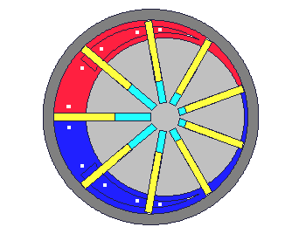
Vane Pump

Slide 2
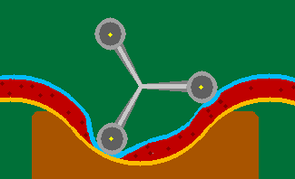
Peristaltic Pump

Slide 3

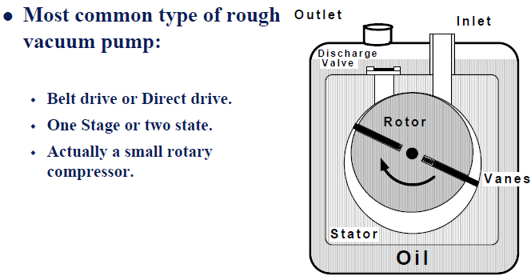
Sliding Vane Rotary Pump (OR)
A sliding vane rotary vacuum pump is a rotary vacuum pump in which an eccentric rotor slides tangentially along the interior wall of the stator (housing). Two or more (usually radialy) movable vanes arranged in rotor slots slide along the interior wall of the stator and divide the pump chamber into cavities with variable volumes

Slide 4
PREVIOUS CLASSES
1- Error analysis
2- Precession, Resolution etc.
3- Examples of different applications of Vacuum Techniques
4- Units of Pressure and its conversions
5- Basics of Gas Properties
6- Gas laws
7- Velocity of gasses etc.
8- Molecular incident rate, Mean free path
9- Viscosity and diffusion of gases
10- Thermal diffusion: Distinction of gas flow and connections
1- Question: Modify the design of McLeod gauge for the better resolution of pressure measurement
2- Write a computer programme (Software development) to calculate the conductance for different connection design
3- Write a computer programme to calculate the throughput and pumping speed required for the vacuum chamber
Positive displacement
Vacuum PUMPS

Slide 5
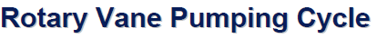
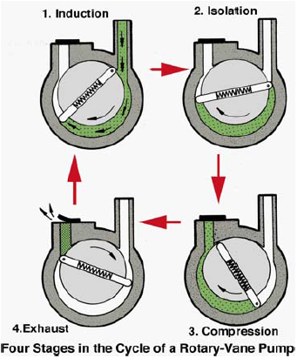

Slide 6
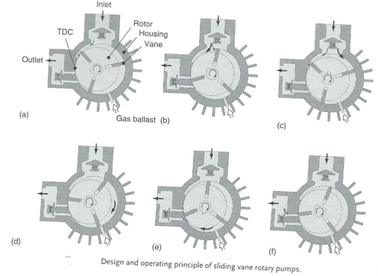
Oil or Dry

Slide 7
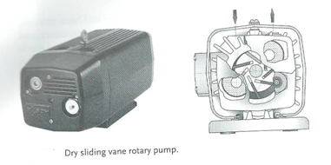
Dry pump--------------------------------------------Oil pump
Maintenance: 2000 to 10000 operating hours-------------more due to oil(no specific)
Volume flow rates: 1.5m³/h-500m³/h--------------3m³/h-1600m³/h
Ultimate pressure: 80hPa-200hPa------------0.1hPa-20hPa
1hPa=100Pa

Slide 8
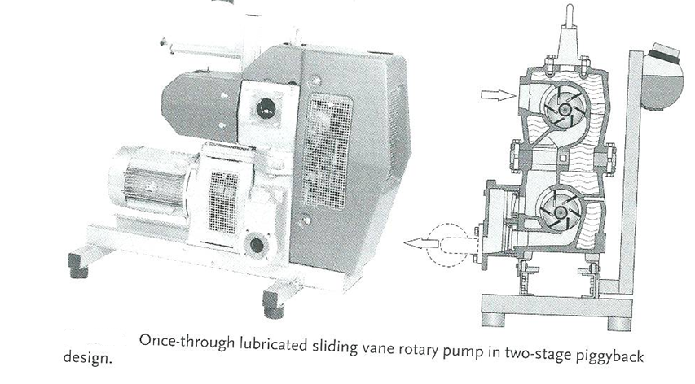
Once-Through Lubricated Sliding Vane rotary Pumps
Continues liquid supply
Available: 160m³/h and 780m³/h
Too high temperature harm the oil, so heat is divided in two stages

Slide 9
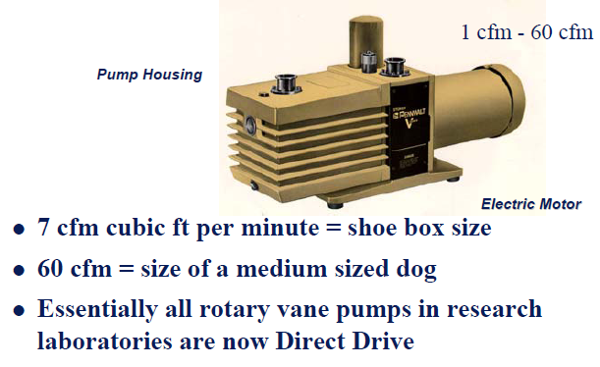
Typical Direct Drive Vane Pump

Slide 10
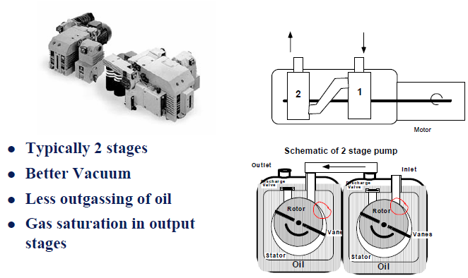
Rotary Vane Pumps

Slide 11
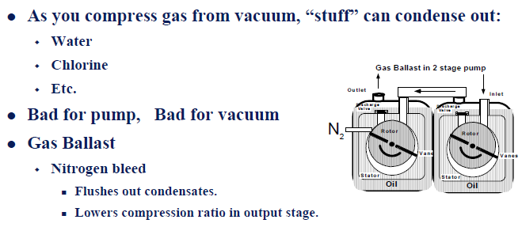

Slide 12

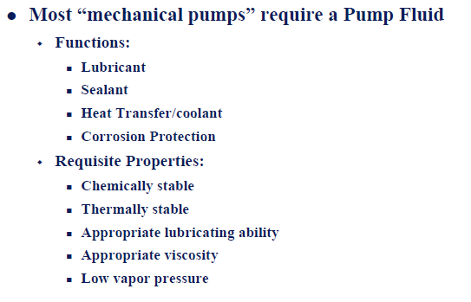

Slide 13
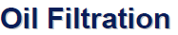
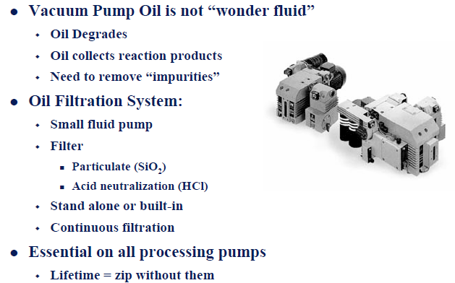

Slide 14
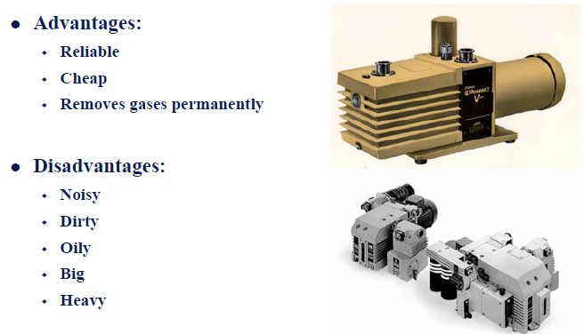

Slide 15
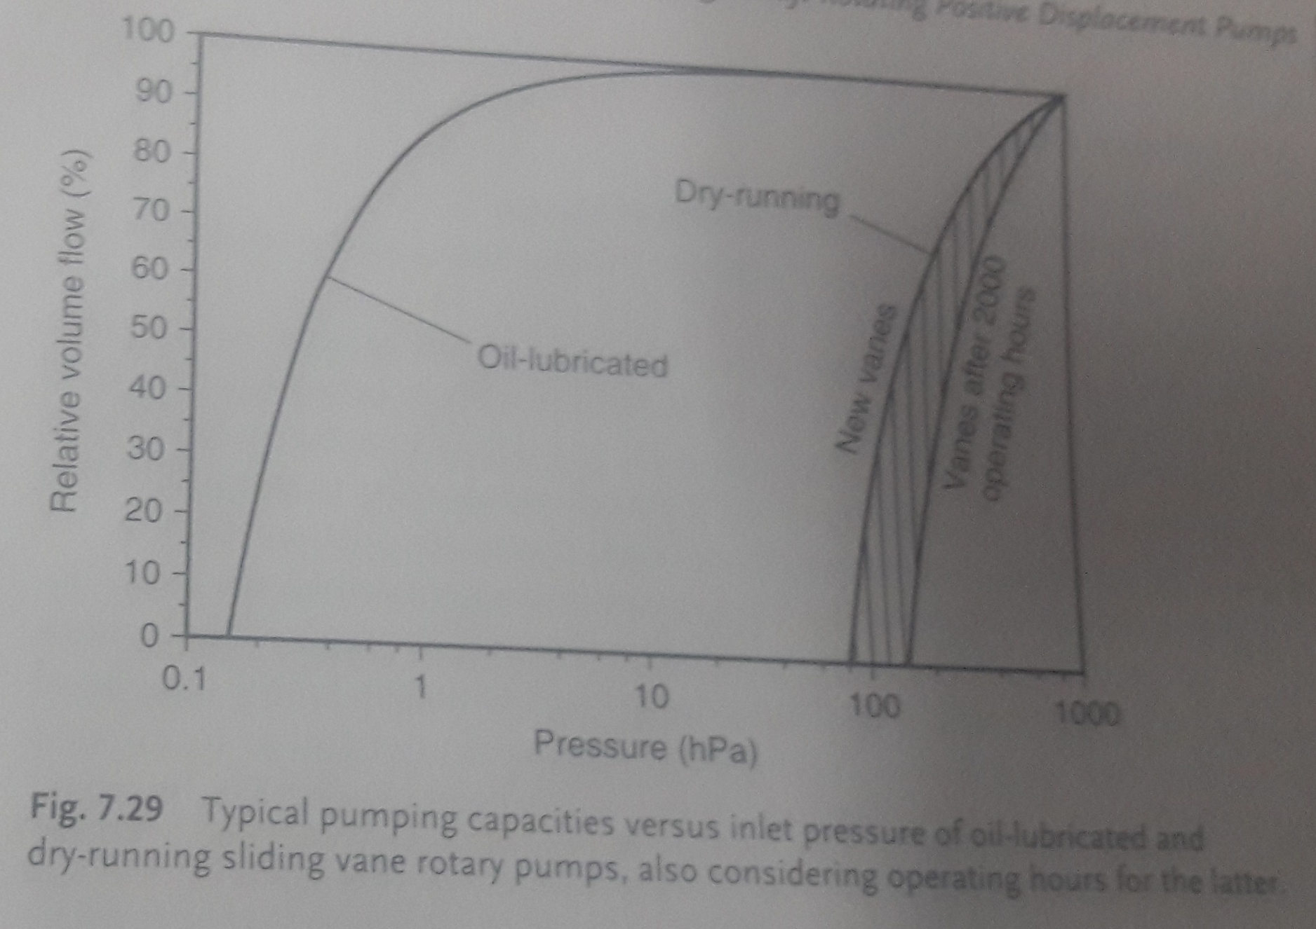
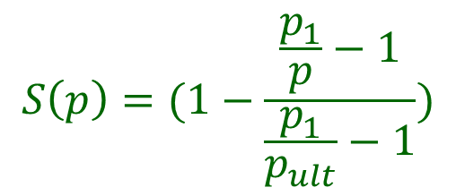
$$S\left(p\right)=(1−\frac{\frac{p_{1}}{p}−1}{\frac{p_{1}}{p_{ult}}−1})$$

Slide 16
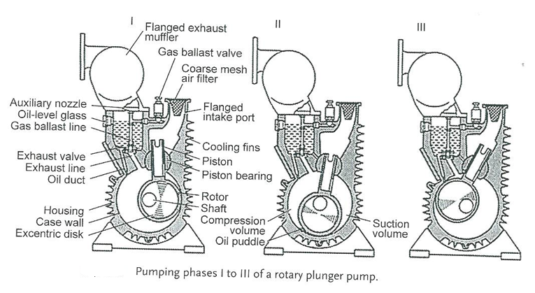
Rotary Plunger Pumps

Slide 17
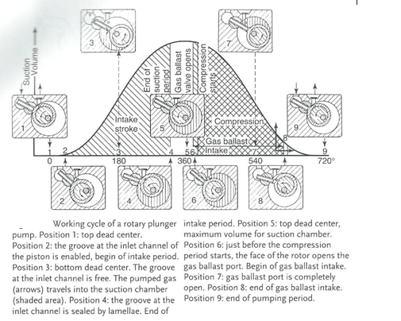

Slide 18
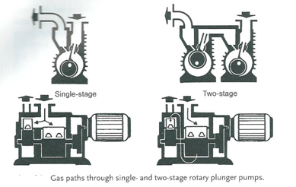
Produce approximately same ultimate pressure of sliding vane rotary pump
Motion of the rotary plunger pump is is contrained
The root runs along the case walls in non-contact operation-> no wear. However wearing in bearing between eccentric guidance and the rotor as well as in the guiding surfaces of the piston

Slide 19
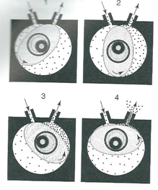
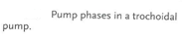
TROCHOIDAL PUMPS

Slide 20
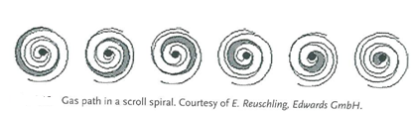
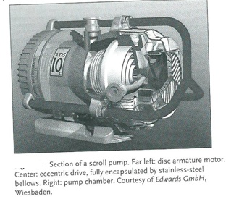
SCROLL PUMP

Slide 21
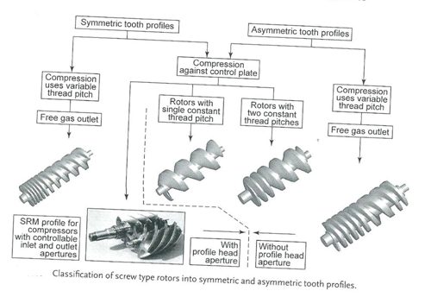
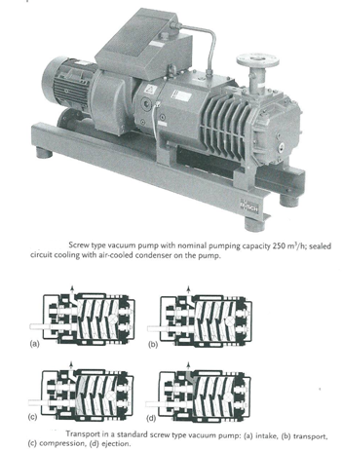
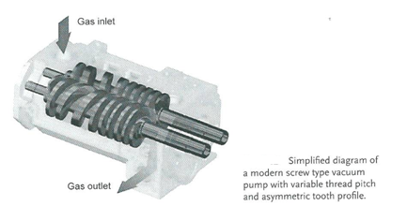
Screw type Pumps

Slide 22
PREVIOUS CLASSES
1- Error analysis
2- Precession, Resolution etc.
3- Examples of different applications of Vacuum Techniques
4- Units of Pressure and its conversions
5- Basics of Gas Properties
6- Gas laws
7- Velocity of gasses etc.
8- Molecular incident rate, Mean free path
9- Viscosity and diffusion of gases
10- Thermal diffusion: Distinction of gas flow and connections
1- Question: Modify the design of McLeod gauge for the better resolution of pressure measurement
2- Write a computer programme (Software development) to calculate the conductance for different connection design
3- Write a computer programme to calculate the throughput and pumping speed required for the vacuum chamber
Positive displacement
Vacuum PUMPS

Slide 23
Positive Displacement Pumps
DIN 28400: Section 2(1980): ISO3529: Vacuum pump that aspirates, compresses and discharges a gas to be pumped, using valves if necessary, by means of pistons, rotors, sliders, etc. which are sealed from another either with or without liquids.
Oscillating positive displacement pumps
Piston pumps
Diaphragm pumps
Rotary positive displacement pumps
Single-spool Twin Spool
Liquid ring pumps Screw type pump
Sliding Vane rotary Claw Pumps
Multi stage pumps Roots Pumps
Rotary plunger pumps
Trochoidal pumps
Scroll pumps

Slide 24

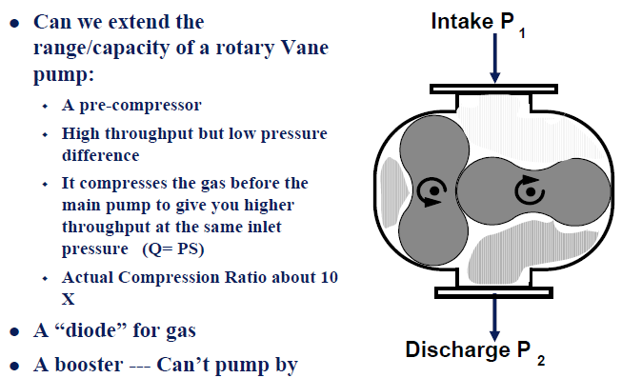

Slide 25

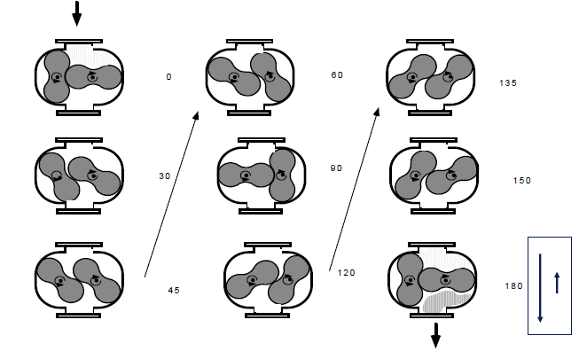

Slide 26

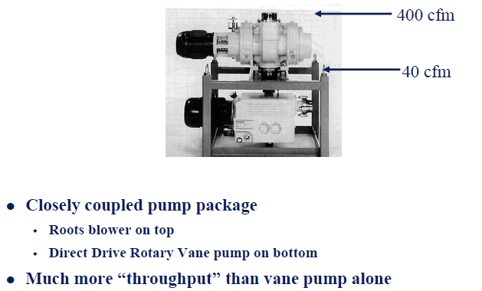

Slide 27

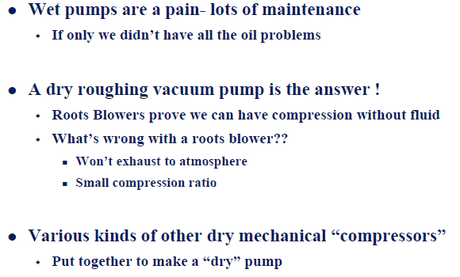

Slide 28
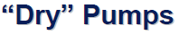
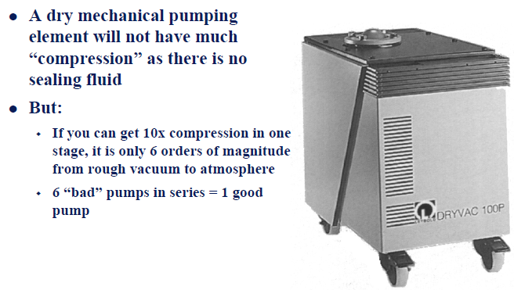

Slide 29
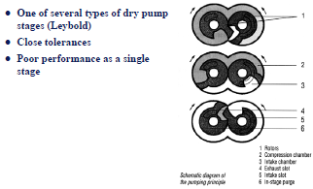

Slide 30
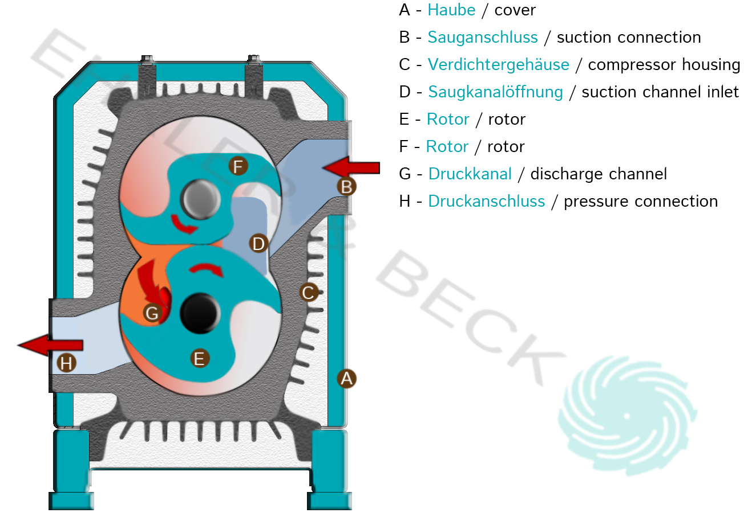

Slide 31
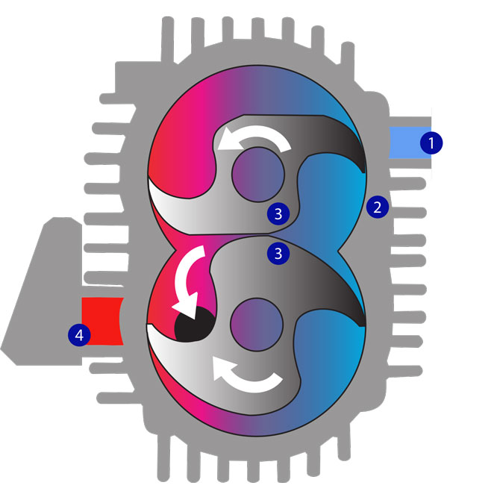
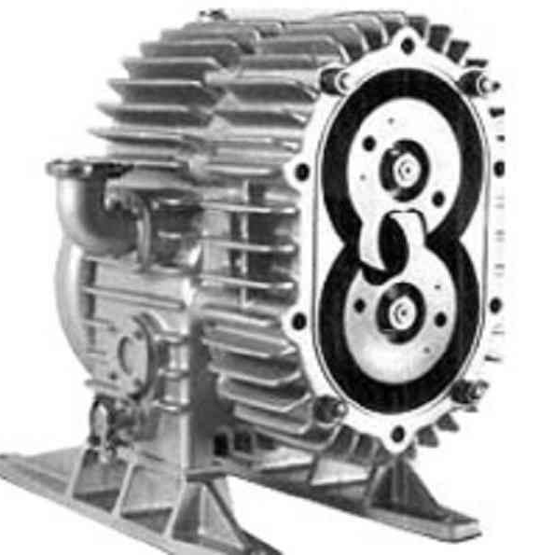
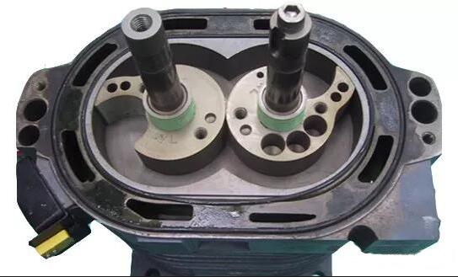

Slide 32
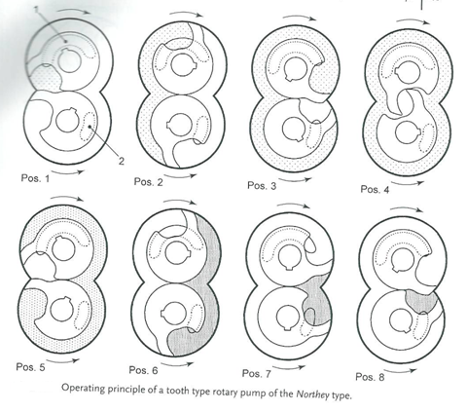

Slide 33
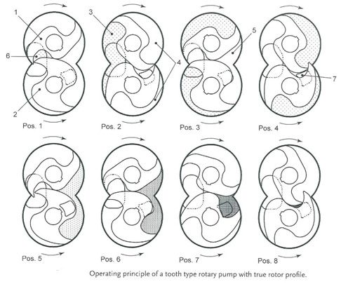

Slide 34
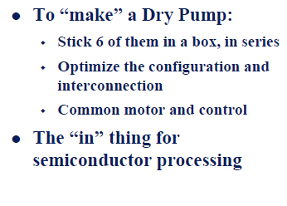
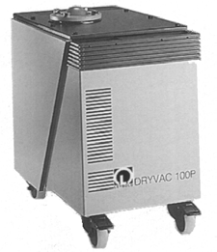

Slide 35
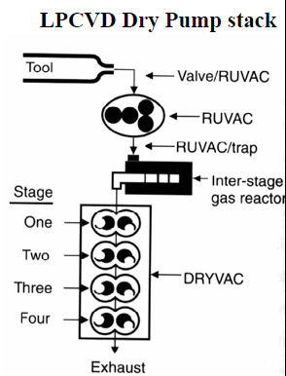

Slide 36
Basics of positive displacement Pumps
Pumping down vapours-gas ballast
1- It compress from inlet pressure to atmosheric pressure or higher; are inappropriate for pumping pure water vapour.
2- It is because the working temperature of pumps <100⁰C. So water vapour condense during compression inside the pump.
3- Standard operating temperature~80⁰C. Saturation vapour pressure(In this pressure water does not compress any more but condense at constant pressure 470mbar) of water ~470mbar
4- Water accumulate inside the pump and carried over to inlet and considerable reduce the altimate pressure due to re-evaporation.
5- Affect to oil in the pump->Jam inside the pump.
6- Corrosion arises
7-It is also applied to other liquids with saturation vapour pressure below outlet pressure (approximately 1100mbar)

Slide 37
Prevention
1- Raising the pump temperature to approximately 110⁰C, i.e. by using a heater or installing thermal insulation.
2- Continuous oil regeneration or exchange can be used.
3- Gas ballast: A controlled amount of fresh gas is fed continuously to the suction chamber of pumps. Thus the opening pressure of the outlet valve is reached before the water vapour is compressed to the saturation vapour pressure corresponding the pump temperature and therefore, before condensation occurs.

Slide 38
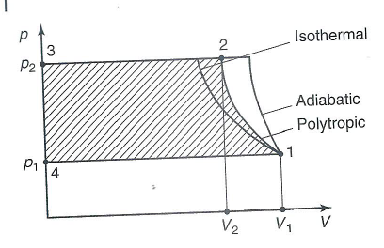
Water vapour tolerance (P_{W}): The maximum pressure at which a vacuum pump can fetch and deliver pure water vapour under standard condition.
(manufacturers specify these values usually in mbar)
Water vapour capacity(C_{w}): Heaviest mass of water per unit time. In other way, water vapour mass flow (q_{m,w}).
q_{p,v}=P_{w}S (M_{molar}/RT)=q_{pV}(M_{molar}/RT) called water vapour capacity.
POWER REQUIREMENTS:
dw = -PAdl=-PdV
1- Isothermal compression:
2- Adiabatic compression:
3- Polytrophic compression:
Compress power=simply product of isothermal, adiabatic and polytrophic

Slide 39
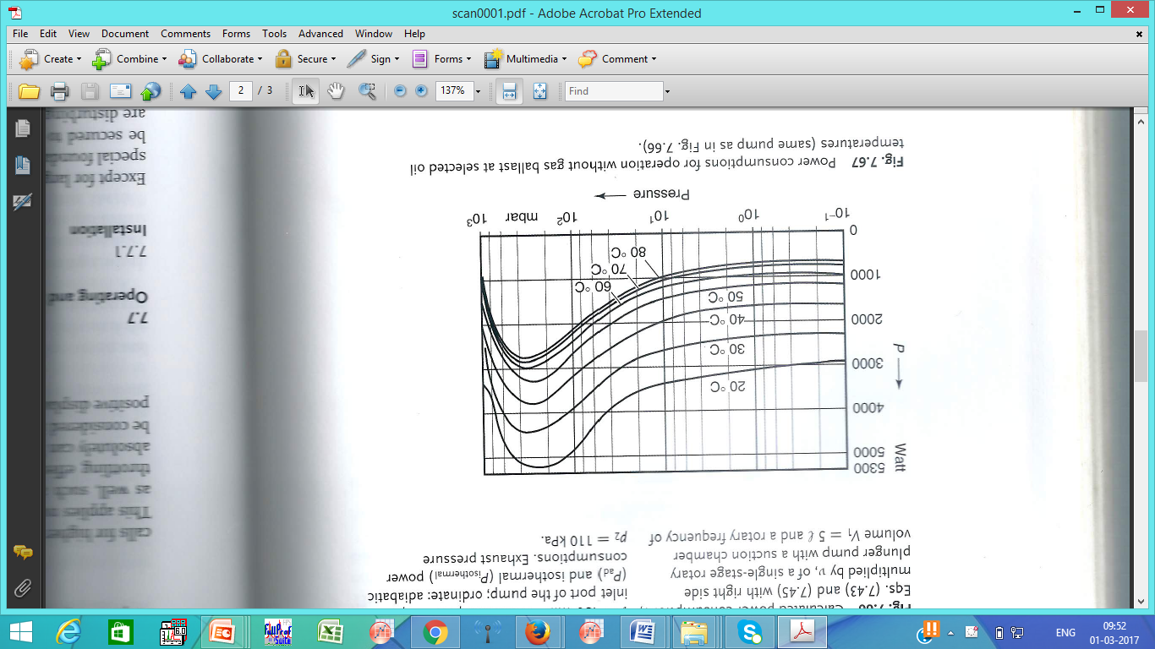
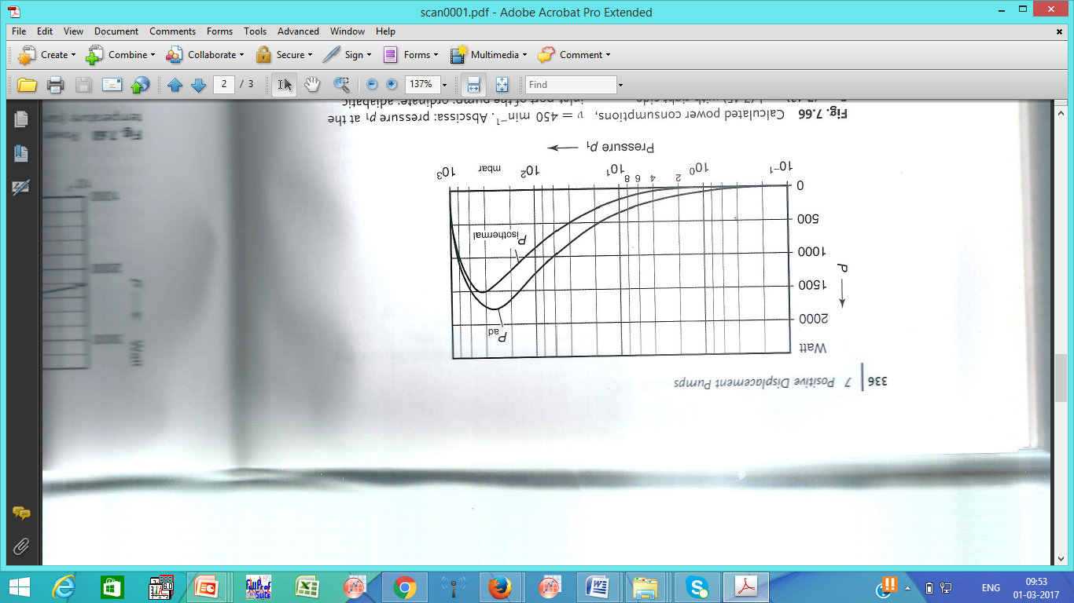
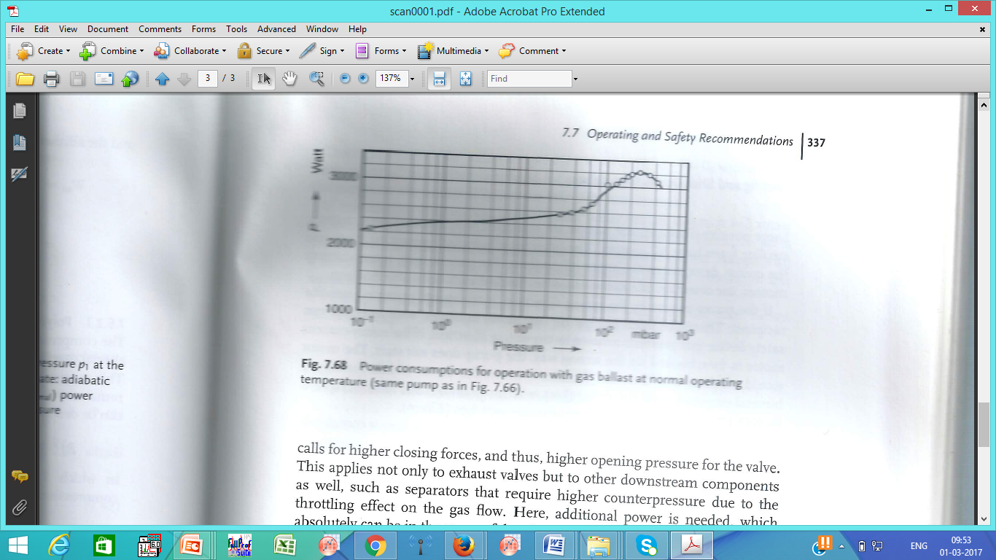

Slide 40
PUMPING SPEED AND PRODUCIBLE ULTIMATE PRESSURE
300-1500min⁻¹, some times upto 3000min⁻¹
PUMPING SPEED AND ULTIMATE PARTIAL PRESSURE
Positive displacement pumps pumping speeds and ultimate pressures are nearly constant for all gases.
ULTIMATE PRESSURE AND OIL SELECTION
Mineral oils
Heavy silicon oil (CR 200, DC 705)
Diffusion oil with very low vapour pressure …. Not suitable
Any mineral oil with appropriate lubricating properties and proper viscosity is suitable as pump oil. (kinematic viscosity at 50⁰C approximately 60cSt=60mm²/s).
Pure mineral oils with a slight corrosion protection, anti-emulsifying additives and oxygen inhibitors.
During operation of oil sealed positive displacement pumps, oil vapour flows in the direction opposite to the flow of pumped gases and vapours. It reaches the inlet of the pump and the suction pipe and if no high- vacuum pump is present , arrives at the vacuum chamber.
OIL BACKFLOW

Slide 41
OPERATING AND SAFETY RECOMMENDATION:
Except large piston pump all other positive displacement pump runs smooth.
They should secure to floor. The vibration disturb at recipients. So damping element ( cushioning device).
Pumped gas may harmful. So connected to a central exhaust. It has to take care by considering vibration, poisonous gas etc.
Starting and shut down inlet valve
Mostly AC motor. So direction of the pump should be checked before start. If wrong rotation, oil transport to recipient. Safety device - > if the current is in wrong direction, it does not work.
Motor over heat: Sensor to cut-off
AC motor draw high current at the starting point. So, current rating should be checked. Also spike current. Excess current safety
Designed to start even at 5% under voltage
The lowest starting temperature is the mean temperature of the pump at which the pump starts flawlessly with ventilated inlet using a driving motor supplied or recommended by the manufacturer after operating was interrupted for a minimum of one hour. If no temperature is specified, 12⁰C is the lowest starting temperature.
Temperature rise to 70-90⁰c. It is good for pumping, not alarming. But it should be tolerable for pump oil.
When stops, one has to take care about the back rotation. Mostly by sealing the recipient.

Slide 42
PUMP SELECTION
Single stage oil filled pumps are better for beginning (10Pa)
For below100Pa, gas ballast required. Also other components: separator, filter devices, exhaust filters, etc.
Technical Safety recommendation:
Explosive area (Mostly avoid dry pumps, as expand and wearing and explosion)
High reactive area
Environment etc.

Slide 43
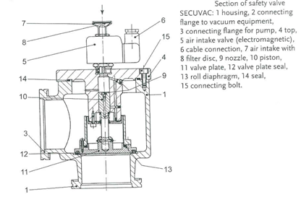
SPECIFIC ACCESSORIES
Sorption Traps: To prevent oil from emanating out of an oil sealed positive displacement pump and reaching the high –vacuum part of a vacuum system.
SAFETY VALVEs: Separate the inlet from the recipient and vents the pump in case power failure or when the pump is shut down

Slide 44
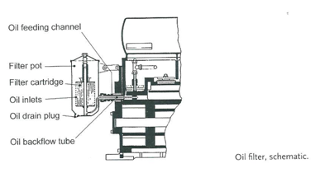
OIL FILTER AND OIL CLEANING

Slide 45
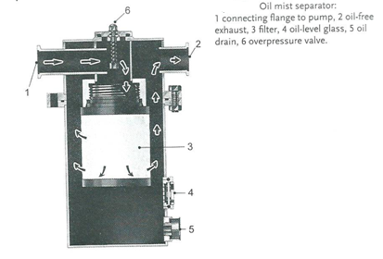
Exhaust Filter:
Due to the intense mixing of gas and pump oil during compression and ejection phases, a vacuum pump not only delivers pumped gas at the exaust but also oil particle.
The droplet size of the oil aerosol in the exhaust is in the range of 0.01-0.8μm
Fibrous or ceramic is difficult… so fine borosilicate fibres

Slide 46

DUST FILTERS

Slide 47
Open book assignment
1- Design a temperature measurement equipment to measure temperature from 50K to 600K (precision =0.001K, reliability=0.01K, repeatability=0.01K, sensitivity=0.001K and Accuracy=0.1K) . Describe the sources of errors during the operation of equipment. Design a transducer to display the temperature.
2. Design a vacuum twiser by using proper vacuum to be used in scientific laboratories (take any research lab in the consideration). Make sure that it is sensitive to the material to be picked up for use.
3. Design a vacuum foreshape to be used in medical surgery to pick up veins, intestine, stones from gallbladder etc. Biological parts are very soft may damage during operation, so take care the power of pump in your design to pick up the materials from 1mg to 50g.
4. Design a vacuum lift to be used in the airport with maximum lifting capacity upto 100kg. How will take care about irregular shape material.
5. Design an industrial vacuum cleaner with variable capacity.
6. Describe working principle of root pump. Design a chamber to be made vacuum ((r=10m, h=40m). Optimize the time required in your design to reach the ultimate pressure 10⁻³torr.
7. Design a spherical chamber (diameter=50cm) of 10⁻⁶ torr vacuum. Vacuum will better for which symmetry chamber: justify your answer. Describe each part used in the pump and chamber including materials.
8. Discuss the use of vacuum science in common people and give an account, how you can implement vacuum for common man benefit.

